Slide 1
Computer Architecture Concepts
Part 15 – Little Man Computer

Slide 2
Objectives
Little Man Computer – introduces concepts of how processors work:
ALU, registers, instruction set
Memory (RAM)
Fetch-execute cycle (also called fetch-decode-execute)
The Little Man Computer slides are based on Chapter 6 from:
The architecture of computer hardware and systems software: an information technology approach by Englander, Irv

Slide 3
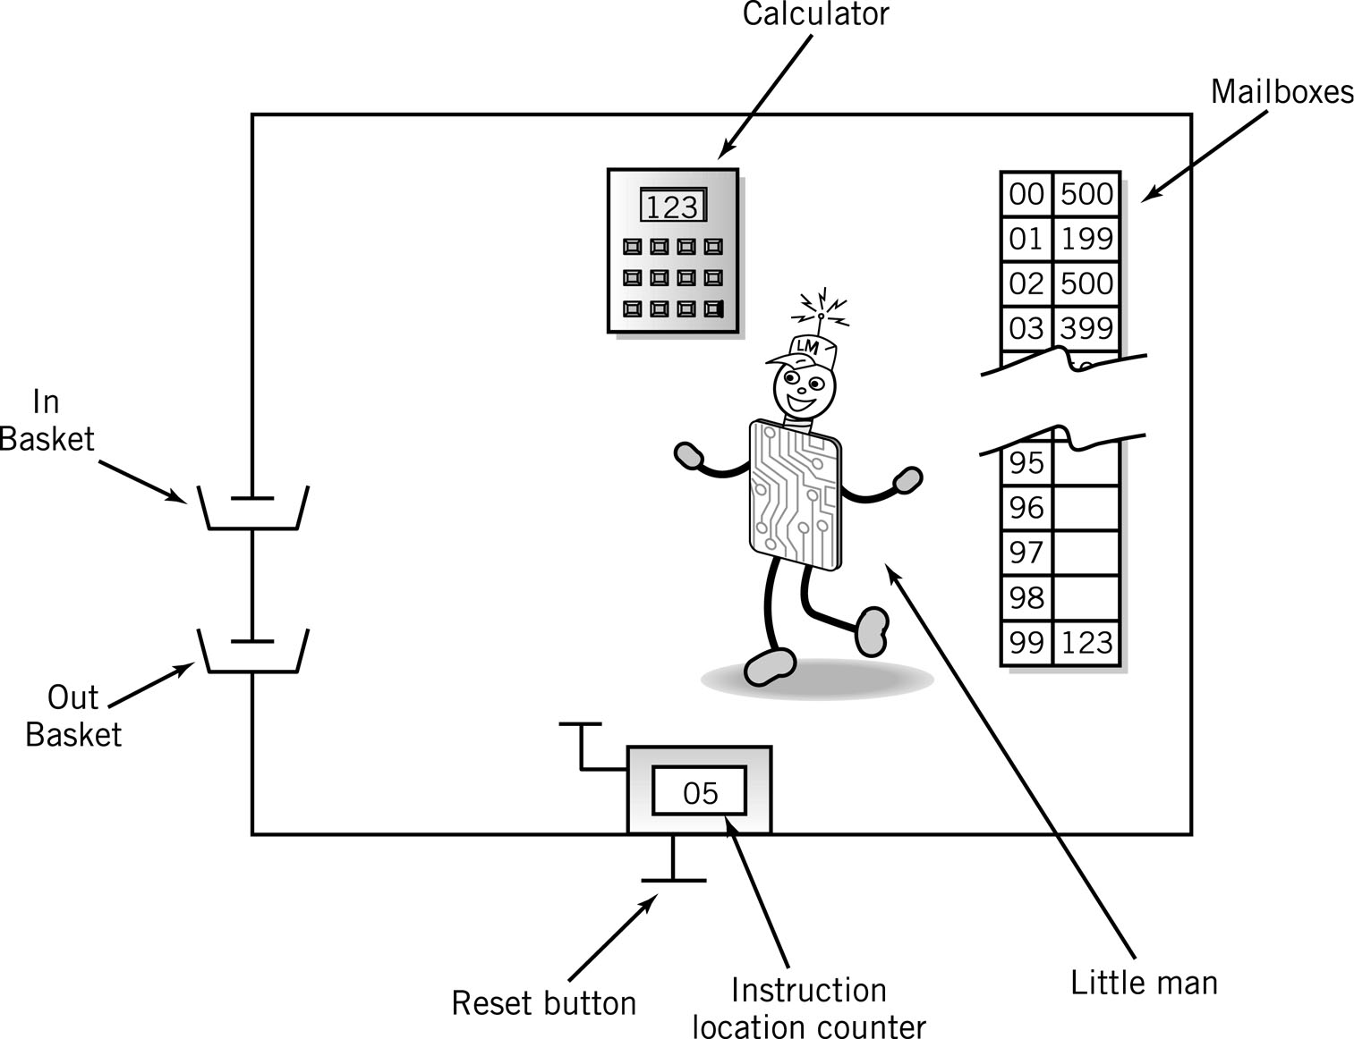
The Little Man Computer

Slide 4
The Little Man Computer
Models the Fetch Execute cycle in Von Neumann architecture (1945)
Model originally proposed at MIT for understanding computer processors which uses decimal instead of binary for simplicity.
Little man – control unit
Calculator – accumulator and ALU
Can hold a three-digit number – use the screen to temporarily hold a number as well as using the calculator to add/subtract
Mailboxes – memory (RAM)
One hundred mailboxes (numbered 00 to 99) each can hold 3 digits
Mailboxes addressed in order and can the storage can be data or instructions
Instruction location counter – program counter register
Push button to add 1 to the counter
Reset button is outside the room

Slide 5
Mailboxes – Von Neumann architecture
Program must be in the mailboxes for the computer to run (stored program)
Addresses (the mailbox numbers) are consecutive starting at 00 and ending at 99
Each mailbox can contain a three-digit number representing
Data or
Instructions
Memory is addressed by location number without regard to content

Slide 6
Instructions in the mailbox
When the content in the mailbox represents an instruction, the three digits are considered in two parts
Op code (first digit)
Operation code – corresponds to an instruction the computer can carry out
Each computer has a specific set of instructions it can do (the instruction set) and each instruction has a code
When we write instructions we tend to use a 2 or 3 letter code (assembler) to make it easier for humans to read, we assemble those instructions to create the digits.
Operand (next two digits)
Object to be manipulated – again this can be data or the address of data (mailbox number).
Remember that the mailboxes are numbered with two digits, so we can always refer to any of the mail boxes with these two digits.

Slide 7
Input/Output
Move data between calculator display and in/out baskets
 |  | Content
 |  | Op Code | Operand
INP (input) |  | 9 | 01
OUT (output) |  | 9 | 02

Slide 8
Internal Data Movement
Op code is 3 or 5
Move data between mailbox and calculator (between RAM and CPU)
STA copies from calculator display and puts in the mailbox numbered by XX
LDA goes to the mailbox numbered XX, gets the contents and copies to the calculator display
 |  | Content
 |  | Op Code | Operand (address)
STA (store) |  | 3 | xx
LDA (load) |  | 5 | xx

Slide 9
Arithmetic Instructions
Op code is 1 or 2
Go to the mailbox address XX and get the value
ADD (or subtract) that value to (from) whatever is already showing in the calculator
 |  | Content
 |  | Op Code | Operand (address)
ADD |  | 1 | xx
SUB |  | 2 | xx

Slide 10
Data storage location
Physically identical to instruction mailbox
Not located in instruction sequence
Identified by DAT mnemonic

Slide 11
Running a program
Store the program in the mailboxes starting from 00
Reset the instruction location counter to 00
Fetch execute cycle
Fetch: Little man finds out what instruction to do
Go to mailbox given in instruction counter and reads the three digit number stored there
Execute: Little man carries out the instruction given by that number
Little man increments the location counter
Carry on until the instruction is 000 (Halt)

Slide 12
Program to Add 2 Numbers:
Mailbox | Code | Mnemonic | Instruction Description
00 | 901 | INP | Go to input basket read what’s there and put in calculator display (accumulator)
01 | 399 | STA 99 | Copy the number from the calculator display and put in mailbox numbered 99
02 | 901 | INP | Go to input basket read what’s there and put in calculator display (accumulator)
03 | 199 | ADD 99 | Go to mailbox 99, get the contents and add to whatever’s already on the calculator display
04 | 902 | OUT | Copy the number from the calculator display and put in the output basket
05 | 000 | HLT | Stop run
99 | 000 | DAT 00 | data

Slide 13
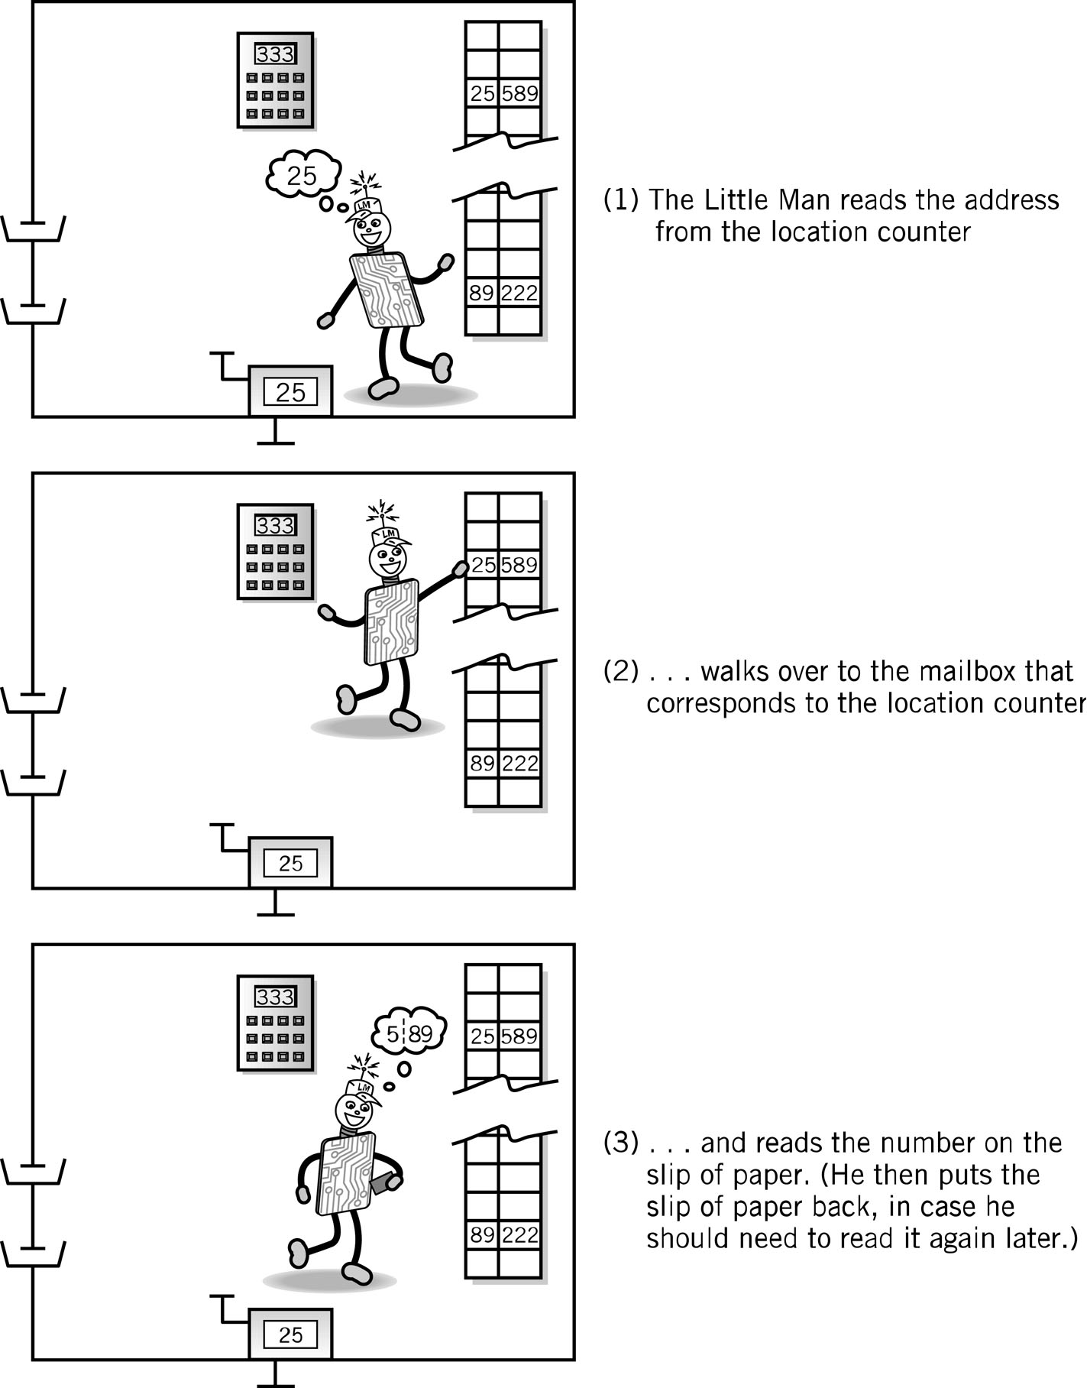
Fetch Portion of Fetch and Execute Cycle
1. Little Man reads the address from the location counter
2. He walks over to the mailbox that corresponds to the location counter

Slide 14
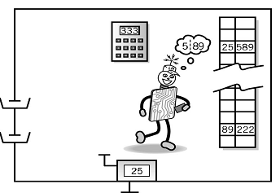
Fetch, cont.
3. And reads the number on the slip of paper (he puts the slip back in case he needs to read it again later)

Slide 15
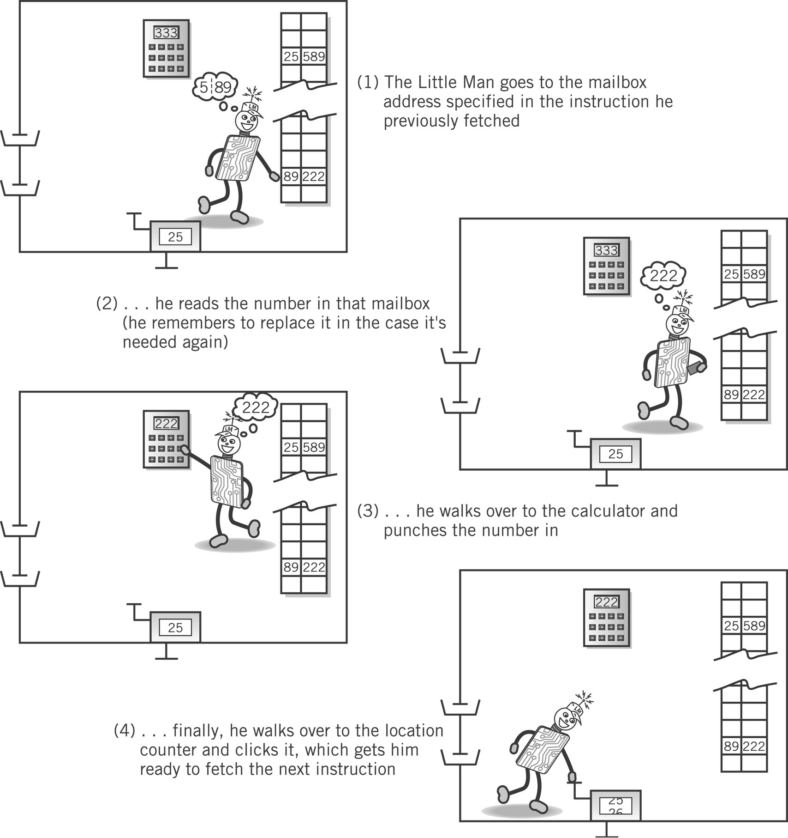
Execute Portion
1. The Little Man goes to the mailbox address specified in the instruction he just fetched
2. He reads the number in that mailbox (he remembers to replace it in case he needs it later)

Slide 16
Execute, cont.
3. He walks over to the calculator and punches the number in
4. He walks over to the location counter and clicks it, which gets him ready to fetch the next instruction

Slide 17
Instruction set
Mnemonic | Name | Description | Op Code
INP | INPUT | Retrieve user input and stores it in the accumulator. | 901
OUT | OUTPUT | Output the value stored in the accumulator. | 902
LDA | LOAD | Load the Accumulator with the contents of the memory address given. | 5xx
STA | STORE | Store the value in the Accumulator in the memory address given. | 3xx
ADD | ADD | Add the contents of the memory address to the Accumulator | 1xx
SUB | SUBTRACT | Subtract the contents of the memory address from the Accumulator | 2xx
BRP | BRANCH IF POSITIVE | Branch/Jump to the address given if the Accumulator is zero or positive. | 8xx
BRZ | BRANCH IF ZERO | Branch/Jump to the address given if the Accumulator is zero. | 7xx
BRA | BRANCH ALWAYS | Branch/Jump to the address given. | 6xx
HLT | HALT | Stop the code | 000
DAT | DATA LOCATION | Used to associate a label to a free memory address. An optional value can also be used to be stored at the memory address.

Slide 18
Summary
The fetch-execute cycle describes the basic operation of modern computers.
The Little Man Computer model shows aspects that apply to modern computers but in a simplified format

